Slide 1

Federated learning with hierarchical clustering of local updates to improve training on non-IID data

Slide 2
Problem
the joint model produced by FL suffers in terms of test set accuracy and/or communication costs compared to training on iid data.

Slide 3
contributions through this work include:
• A method for training specialized models for subsets of clients that can increase test set accuracy whilst reducing the number of communication rounds required to reach convergence. This is achieved by clustering the clients by similarity based on their updates to the global joint model after a set number of communication rounds.
• A full characterization of how hierarchical clustering affects test set accuracy when applied during FL training in iid and various non-iid settings.
• An empirical analysis of the effect that varying hyperparameters for FL and the hierarchical clustering algorithm has on forming good specialized models for subsets of clients.

Slide 4
There are a variety of ways in which the data among clients
Feature distribution skew: This is the case where the input features are not evenly distributed between clients.
Label distribution skew: This is the case where the data labels are not evenly distributed between clients. For example, some clients only have access to data from a subset of all possible labels for a given task.
Concept shift (same features, different label): Here different labels are assigned for the same features across clients. For example, client i labels all cat images as ’cat’, but client j labels all cat images as ’dog’.
Concept shift (same label, different features): Here different features across clients are labelled with the same label. For example, client i labels all cat images as ’cat’, but client j labels all dog images as ’cat’.

Slide 5
The Reason for Using Hierarchical clustering
natural choice for the purpose of clustering where the number of clusters is unknown and where all examples are assigned to the most relevant cluster.
Another benefit of using hierarchical clustering is its ability to scale to large numbers of samples and clusters as well as being reasonably interpretable.
The hyperparameters of the hierarchical clustering:
Notes:
other clustering methods that determine the number of clusters automatically fail to assign outlying samples to a cluster and simply label them as noise

Slide 6
Hyperparameters of The Hierarchical Clustering Algorithm
the distance metric uses to compute the similarity between clusters.
(Manhattan)
(Euclidean
second important hyperparameter is the linkage mechanism for determining how similar two clusters are.
Single linkage: determines distance based on the most similar pair of samples across two clusters.
Complete linkage: determines distance based on the most dissimilar pairs of samples across two clusters.
Average linkage: averages the samples within each cluster and compares distances based on these averages.

Slide 7
Related work
Zhao et al. they propose a sharing a small subset of public data with heterogenous clients to reduce the weight divergence between trained local models, thus increasing robustness and stability during training.
Eichner et al. propose a semi-cyclic method to train pluralistic models that perform model averaging over blocks of clients (e.g. clients in particular time zones). In this work clients are clustered where they are located in a shared time zone.
Ghosh et al. they use K-means to cluster client updates for the purpose of identifying and isolating byzantine clusters of clients prior to the averaging step.
Sattler et al. they develop a clustered federated learning (CFL) procedure. This uses an optimal bipartitioning algorithm to separate clients based on cosine similarity for the purpose of producing specialized models for each cluster of clients.

Slide 8
Experiment setup- datasets
The datasets:
MNIST dataset: contains 60,000 training examples and 10,000 test examples.
FEMNIST dataset: is used to classify not only 10 handwritten digits but also 26 uppercase and 26 lowercase letters and is pre-partitioned according to the person who wrote the characters.

Slide 9
Experiment setup-data partitions(IID)
- The iid setting shuffles all the data and divides it among 100 clients evenly (600 training examples each). In this scenario, Pi = Pj for all pairs of clients i and j.

Slide 10
Experiment setup-data partitions(Non-IID)
The first non- iid setting: referred to as pathological non-iid partitions the data such that clients receive digits corresponding to only 2 labels. For example, the first client might receive 300 examples labelled as 2 and 300 examples labelled as 7. In this setting, we test how the FL model performs with label distribution skew.
The second non-iid setting: referred to as label-swapped non- iid. First shuffles the data and then partitions the data into four groups. For each group two-digit labels are swapped. For example, one group might swap all digits labelled as 3 to 9 and vice versa. Each group is then evenly distributed to 25 clients, resulting in 100 clients each with 600 training examples. This way the clients naturally form 4 clusters and allow us to test FL’s ability to train models in the presence of Concept shift (same features, different label).
The Third non-iid setting: Each client has access to an uneven number of samples (between 12 and 386 samples). This scenario tests FL in the presence of feature distribution skew, where P(x) varies over the clients as different users write characters in subtly different ways. Additionally, due to the uneven sample sizes, P(y) will also vary to some degree between clients. This is distribution represent the feature distribution skew,

Slide 11
Experiment setup- Model
convolutional neural network was designed taking single channel, 28 x 28 pixel images and passing these through two 5x5 convolutional layers (32 and 64 channels respectively) with Relu activations.
Each convolutional layer is followed by a 2x2 max pooling layer. Finally the network passes data through a fully connected dense layer with 512 units and Relu activations and provides output via a softmax classification over the 10 possible digit labels (62 in the case of FEMNIST).
Federated Averaging is used to train a global model over 50 training rounds for each data partitioning scheme.
This is repeated using varying client fractions (0.1, 0.2, 0.5 and 1.0) for each round of training.
In these experiments they used mini-batch stochastic gradient descent on the client with a batch size of 10 over 3 epochs per communication round and set the learning rate to 0.1.

Slide 12
Experiment setup- training
First train a global model for n communication rounds.
This global model is then trained for a further 3 epochs on all clients to produce ∆w.
The model parameters are reshaped to form a vector and used as feature inputs to the agglomerative hierarchical clustering algorithm.
The clustering algorithm returns a number of clusters each containing subsets of clients that are most similar to one another. FL then proceeds for each cluster independently for a total of 50 communication rounds.

Slide 13
Result: (iid setting)
In the iid setting, hierarchical clustering was unable to separate clients into clusters for most experiments, instead falling back on the single joint model. This is to be expected as clients with iid partitioned data should return similar updates.

Slide 14
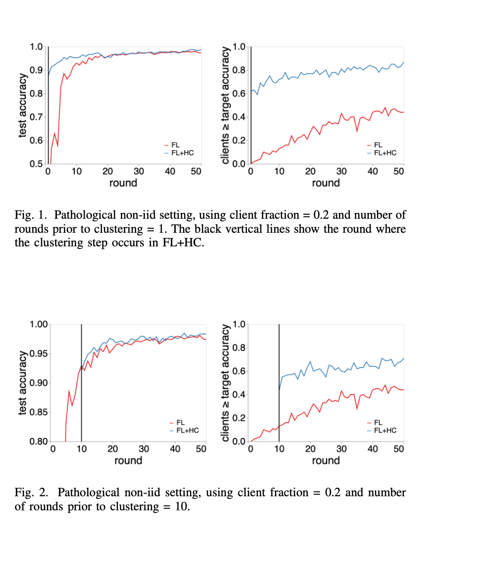
RESULT: (Non-iid setting)
A. Effect of varying client fraction and number of rounds prior to clustering

Slide 15
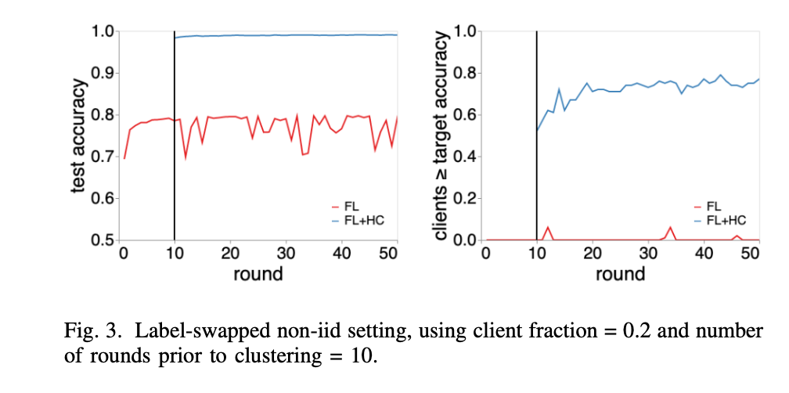
RESULT: (Non-iid setting)
A. Effect of varying client fraction and number of rounds prior to clustering

Slide 16
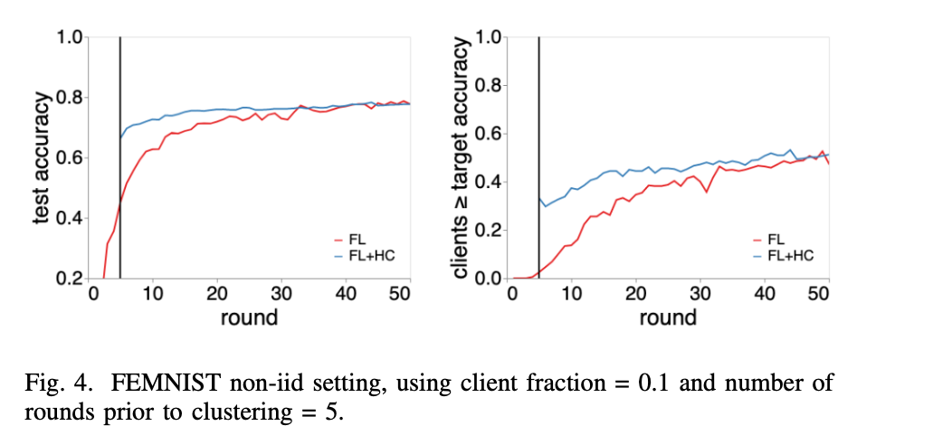
RESULT: (Non-iid setting)
A. Effect of varying client fraction and number of rounds prior to clustering

Slide 17
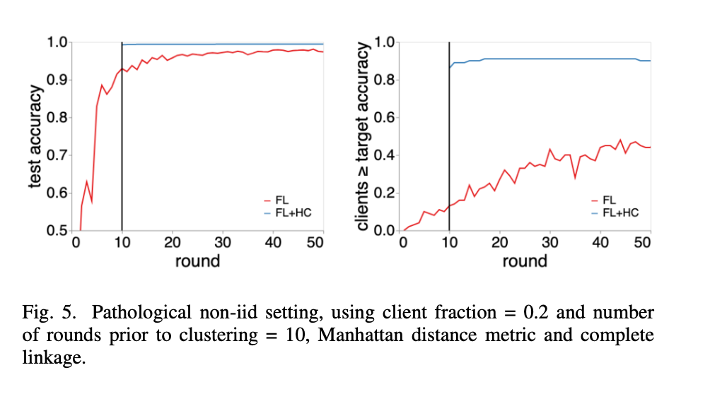
RESULT: (Non-iid setting)
B. Effect of varying hierarchical clustering hyperparameters

Slide 18
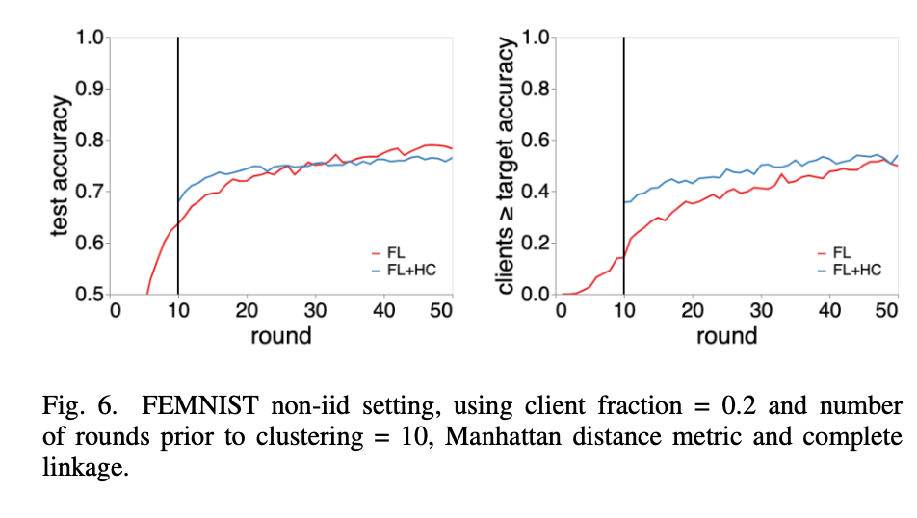
RESULT: (Non-iid setting)
B. Effect of varying hierarchical clustering hyperparameters

